Slide 1

Metric Conversions Ladder Method

Slide 2
Learning Objectives
I can convert units in the metric system.

Slide 3
English Conversions
How many inches in a foot?
How many feet in a yard?
How many feet in a mile?

Slide 4
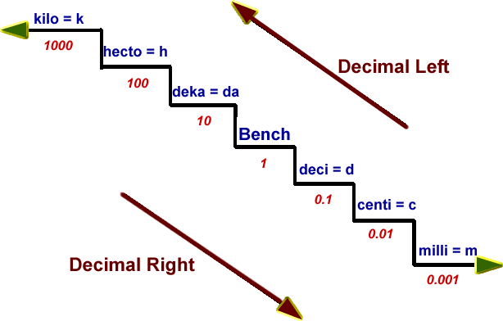
Metric prefixes change the value
(Meter, Liter Gram)

Slide 5
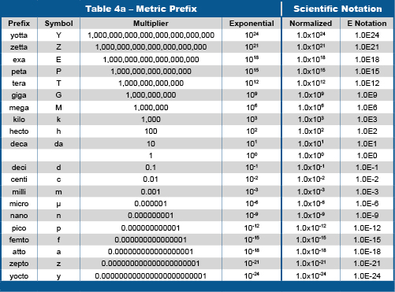

Slide 6
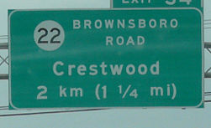
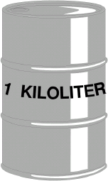
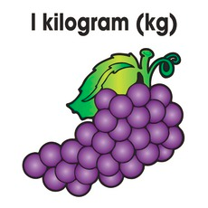
Kilo = 1000
1 kilometer = 1000 meters
1kiloliter = 1000 liters
1 kilogram = 1000 grams

Slide 7
Centi = .01 or 1/100
1 meter = 100 centimeters
1 liter = 100 centiliters
1 gram = 100 centigrams

Slide 8
List of Abbreviations
Kilometer – km
Kiloliter – kL
Kilogram – kg
Centimeter – cm
Centiliter – cL
Centigram - cg
Millimeter – mm
Milliliter – mL
Milligram - mg

Slide 9
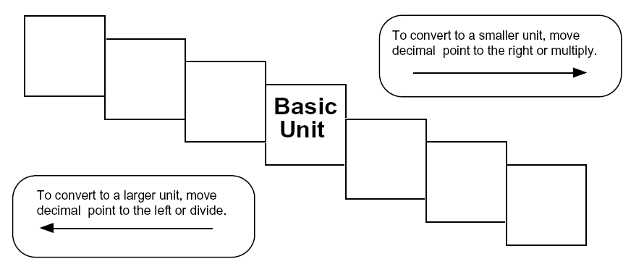
Ladder Method
1
2
KILO
1000
Units
3
HECTO
100
Units
DEKA
10
Units
DECI
0.1
Unit
CENTI
0.01
Unit
MILLI
0.001
Unit
Meters
Liters
Grams
How do you use the “ladder” method?
4 km = _________ m
1st – Determine your starting point.
2nd – Count the “jumps” to your ending point.
3rd – Move the decimal the same number of jumps in the same direction.
Starting Point
Ending Point
How many jumps does it take?
4.
__.
__.
__.
= 4000 m
1
2
3

Slide 10
Ladder Method
KILO
1000
Units
2
HECTO
100
Units
DEKA
10
Units
1
DECI
0.1
Unit
CENTI
0.01
Unit
MILLI
0.001
Unit
Meters
Liters
Grams
How do you use the “ladder” method?
450 cm = _________ m
1st – Determine your starting point.
2nd – Count the “jumps” to your ending point.
3rd – Move the decimal the same number of jumps in the same direction.
Starting Point
Ending Point
How many jumps does it take?
450
= 4.5 m
1
2

Slide 11
Ladder Method
KILO
1000
Units
3
HECTO
100
Units
DEKA
10
Units
2
1
DECI
0.1
Unit
CENTI
0.01
Unit
MILLI
0.001
Unit
Meters
Liters
Grams
How do you use the “ladder” method?
275 mm = _________ m
1st – Determine your starting point.
2nd – Count the “jumps” to your ending point.
3rd – Move the decimal the same number of jumps in the same direction.
Starting Point
Ending Point
How many jumps does it take?
275
= .275 m
1
3
2

Slide 12
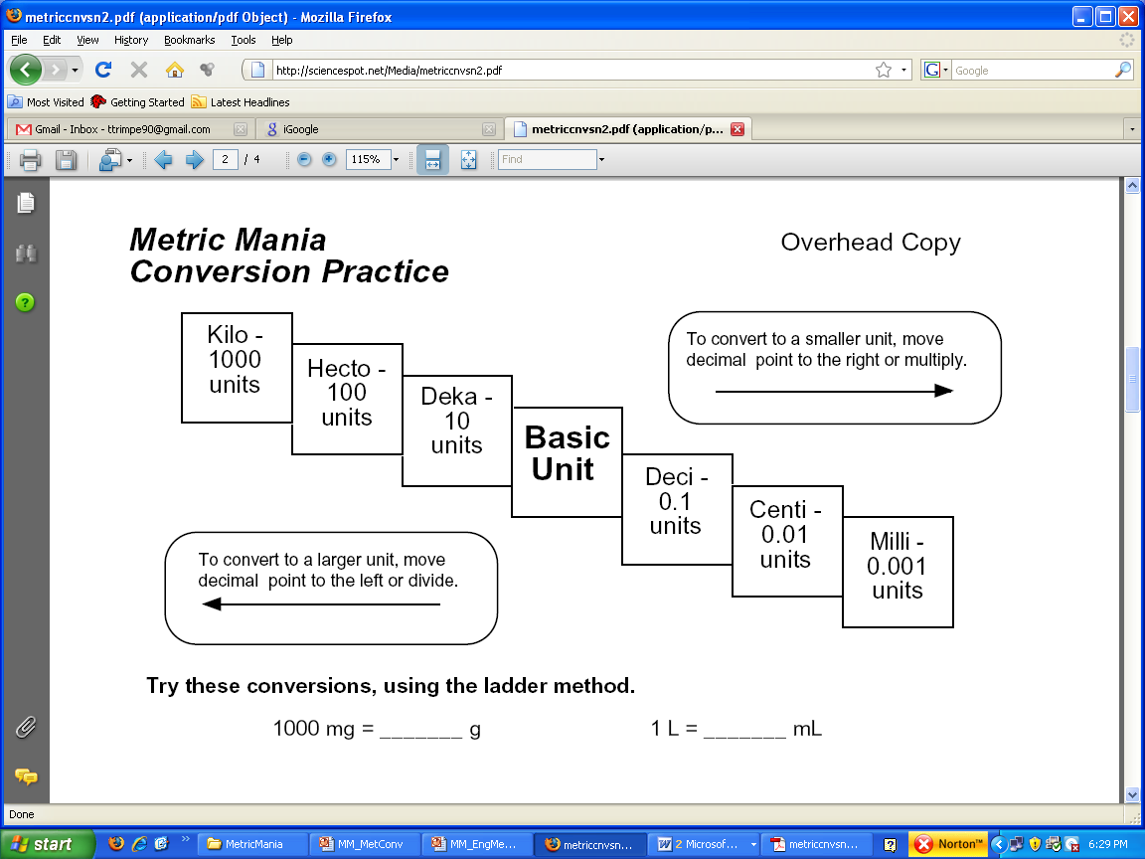
Conversion Practice
Try these conversions using the ladder method.
1000 mg = _______ g 1 L = _______ mL 160 cm = _______ mm
14 km = _______ m 109 g = _______ kg 250 m = _______ km
Compare using <, >, or =.
56 cm 6 m 7 g 698 mg

Slide 13
Metric Conversion Challenge
Write the correct abbreviation for each metric unit.
1) Kilogram _____ 4) Milliliter _____ 7) Kilometer _____
2) Meter _____ 5) Millimeter _____ 8) Centimeter _____
3) Gram _____ 6) Liter _____ 9) Milligram _____
Try these conversions, using the ladder method.
10) 2000 mg = _______ g 15) 5 L = _______ mL 20) 16 cm = _______ mm
11) 104 km = _______ m 16) 198 g = _______ kg 21) 2500 m = _______ km
12) 480 cm = _____ m 17) 75 mL = _____ L 22) 65 g = _____ mg
13) 5.6 kg = _____ g 18) 50 cm = _____ m 23) 6.3 cm = _____ mm
14) 8 mm = _____ cm 19) 5.6 m = _____ cm 24) 120 mg = _____ g

Slide 14
Compare using <, >, or =.
25) 63 cm 6 m 27) 5 g 508 mg 29) 1,500 mL 1.5 L
26) 536 cm 53.6 dm 28) 43 mg 5 g 30) 3.6 m 36 cm

